Slide 1


Core Low-Level Network Technology for Games
Presentation by:
Martin Clouatre,
Jeffrey Rainy

Slide 2
What is DirtySock?
DirtySDK
Client-side library providing networking connectivity between players, and access to server-side services
Multi-platform network technology
Consoles: PC, PS3, XBox360, Wii U, Linux
Mobile platforms: Android, iOS, Vita
DirtyCast
Server-side tech providing building blocks for server-based games, like packets pairing, packet rebroadcasting, etc.
Not covered by this presentation

Slide 3
DirtySDK Overview
Console or Mobile Device
First-Party Network Services
Game Connection Setup
Environment: Prod – Test - Dev
DirtySDK NetConn
Xbox Live
Playstation Network
DirtySDK ConnApi
DirtySDK ConnApi
or game-server custom logic
Game Play
DirtySDK
NetGameDist
DirtySDK
NetGameLink
DirtySDK
NetGameLink
DirtySDK
NetGameDist
DirtySDK
NetGameLinkStream
DirtySDK
NetGameLinkStream
Peer Console or Game Server

Slide 4
NetConn (1/4)
Multi-platform network connection routines
Console or Mobile Device
First-Party Network Services
Game Connection Setup
Environment: Prod – Test - Dev
DirtySDK NetConn
Xbox Live
Playstation Network
DirtySDK ConnApi
DirtySDK ConnApi
or game-server custom logic
Peer Console or Game Server

Slide 5
NetConn (2/4)
XBox360
Brings up network stack in either secure or insecure modes.
Handles XLSP gateway connection and mapping.
Supports one user signed-in to Xbox Live
Multiple local users supported in V9
Relies on HUD for high-level connection module.

Slide 6
NetConn (3/4)
PS3 and Vita
Starts and drives NP network library.
Implements NP ticket request functionality for Sony 3-way user authentication services.
WII U
Starts network stack
Implements Nintendo Authentication Token request functionality. Provides C++ wrappers for the system

Slide 7
NetConn (4/4)
PC, Linux
Most functions are stubs to provide compatibility with other platforms.
Does not include functionality to bring up the network interface; this is assumed to already be done.
Common to all platforms
Provides MAC address of network adapter

Slide 8
DirtySDK core services (1/2)
DirtySDK sockets
Platform-independent sockets implementation
Similar in many respects to BSD Sockets and Winsock, but targeted specifically for a real-time game networking environment
Provides user-definable socket callbacks for real-time processing of UDP data
Provides idle functions for cleanly handling resends and things of that nature

Slide 9
DirtySDK core services (2/2)
Low-level communications protocols
CommUDP
Reliable datagram transport, optimized for network controller passing
Eight-byte packet overhead on top of UDP packet overhead
Supports multiple connections, can act as a server
Supports optional unreliable sending
Recommended choice for most titles
CommTCP
Reliable stream transport, not recommended for game use

Slide 10
NetGameLink (1/2)
Raw game data packet interface
Console or Mobile Device
Peer Console or Game Server
Game Play
DirtySDK
NetGameDist
DirtySDK
NetGameLink
DirtySDK
NetGameLink
DirtySDK
NetGameDist
DirtySDK
NetGameLinkStream
DirtySDK
NetGameLinkStream

Slide 11
NetGameLink (2/2)
Provides per-packet in-order-reliable or unreliable packet transmission
Provides connection status information
Provides connection data transfer statistics

Slide 12
ConnApi (1/4)
Game connection setup routines
Console or Mobile Device
First-Party Network Services
Game Connection Setup
Environment: Prod – Test - Dev
DirtySDK NetConn
Xbox Live
Playstation Network
DirtySDK ConnApi
DirtySDK ConnApi
or game-server custom logic
Peer Console or Game Server

Slide 13
ConnApi (2/4)
High-level module that encapsulates “connect to peer” process, including game and VoIP connections, demangling, and more.
Allows for registering a user-provided callback to get connection-specific events
This module is recommended for all titles

Slide 14
ConnApi (3/4)
Uses NetGameUtil to bring peer networking online.
Internally creates a NetGameLink instance upon successful connection establishment.
That NetGamelLink can then be used by game code for sending/receiving game traffic. (Covered later)

Slide 15
ConnApi (4/4)
“Normal” platforms (not Xbox 360)
Uses ProtoMangle and ProtoUpnp.
XBox360
Uses DirtySessionManager, encapsulating Xbox 360 secure network APIs.

Slide 16
NetGameDist (1/3)
Multi-player input synching tech
Console or Mobile Device
Peer Console or Game Server
Game Play
DirtySDK
NetGameDist
DirtySDK
NetGameLink
DirtySDK
NetGameLink
DirtySDK
NetGameDist
DirtySDK
NetGameLinkStream
DirtySDK
NetGameLinkStream

Slide 17
NetGameDist (2/3)
Implemented on top of NetGameLink
Input synching mechanism:
High level controller/event passing interface
Fixed timing controller passing

Slide 18
NetGameDist (3/3)
Two usability scenarios:
Two-player peer-to-peer topology
N-player DirtyCast topology
DirtyCast runs NetGameDistServ
Commonly used in sports titles (Madden, FIFA, NHL, etc).

Slide 19
NetGameLinkStream (1/2)
Virtual packet channel over a NetGameLink
Console or Mobile Device
Peer Console or Game Server
Game Play
DirtySDK
NetGameDist
DirtySDK
NetGameLink
DirtySDK
NetGameLink
DirtySDK
NetGameDist
DirtySDK
NetGameLinkStream
DirtySDK
NetGameLinkStream

Slide 20
NetGameLinkStream (2/2)
Implemented on top of NetGameLink.
There can can be multiple such streams for one NetGameLink.
Can co-exist with NetGameDist.
Allows for transmission of data buffers larger than the size supported by the NetGameLink API. Provides TCP-like stream interface over UDP link.

Slide 21
Other DirtySDK services (1/5)
VoIP
VoIP connectivity between players
Broadband only (~~2-4k/sec bandwidth required)
Available on PC, PS3, Wii U, and Xbox360
Switches to low-bandwidth pinging if voice data is not available (e.g. no headset plugged in).
XML
XmlFormat: XML generation routines
XmlParse: XML parsing routines

Slide 22
Other DirtySDK services (2/5)
Crypt
Encryption – decryption routines
Supports:
Arc4 (RC4) stream cipher algorithm
AES block cipher algorithm
MD5 digest algorithm
RSA implementation
Recently optimized for improved performance on mobile platforms
Telemetry
Recently split off into a dedicated SDK.

Slide 23
Other DirtySDK services (3/5)
Miscelleneous protocols
ProtoHttp :
http/https client
ProtoSSL :
Secure sockets layer protocol
ProtoPing :
Basic ICMP ping service
ProtoMangle :
EA.com Demangler client, for NAT workaround
ProtoAdvt:
Subnet advertising protocol for broadcasting game advertisements over a LAN

Slide 24
Other DirtySDK services (4/5)
Proto (continued)
ProtoTunnel :
Simplified VPN-like functionality for UDP sockets
Tunnels multiple game and voip connections over a single UDP connection
Provides virtual ports, allowing upper layers to use a normal port metaphor without requiring physical ports
Simplifies NAT traversal: a single port is required for game and voice data, instead of two
Allows more efficient bundling of game and voice data
Game data is encrypted

Slide 25
Other DirtySDK services (5/5)
Proto (continued)
ProtoHttpManager:
Manages multiple ProtoHttp refs allowing efficient web-browser like operation when referencing sets of network resources in parallel, as with images on a web page. Used in EA WebKit.
ProtoStream:
Provides streaming circular buffer for streaming audio or video over the network
ProtoUPnP:
Implements a small subset of UPnP functionality focused on NAT bypass
Uses WANConnectionDevice interface to open a static port mapping on user’s UPnP-enabled NAT device

Slide 26
Joining a game (1/4)
Options for Game connection setup
Console or Mobile Device
First-Party Network Services
Game Connection Setup
Environment: Prod – Test - Dev
DirtySDK NetConn
Xbox Live
Playstation Network
ConnApi or ProtoAdvt
ConnApi or ProtoAdvt
Peer Console or Game Server

Slide 27
Joining a game (2/4)
DirtySDK needs to learn about other players to be able to put some of them in a game. Two main techniques:
Using a “Lobby” server. For example: a Blaze Server.
Using LAN advertisements.

Slide 28
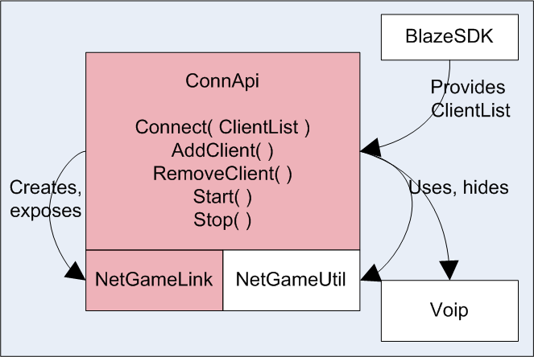
Joining a game (3/4) Find peers through Blaze

Slide 29
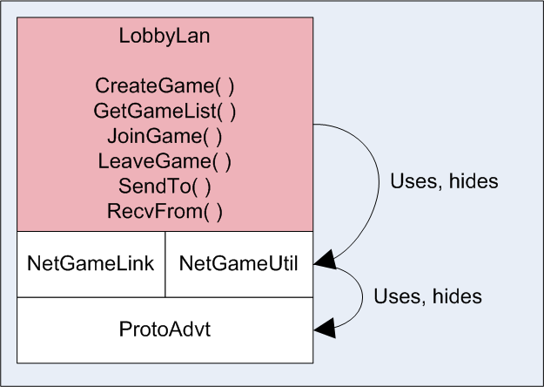
Joining a game (4/4) Using LAN advertisements

Slide 30
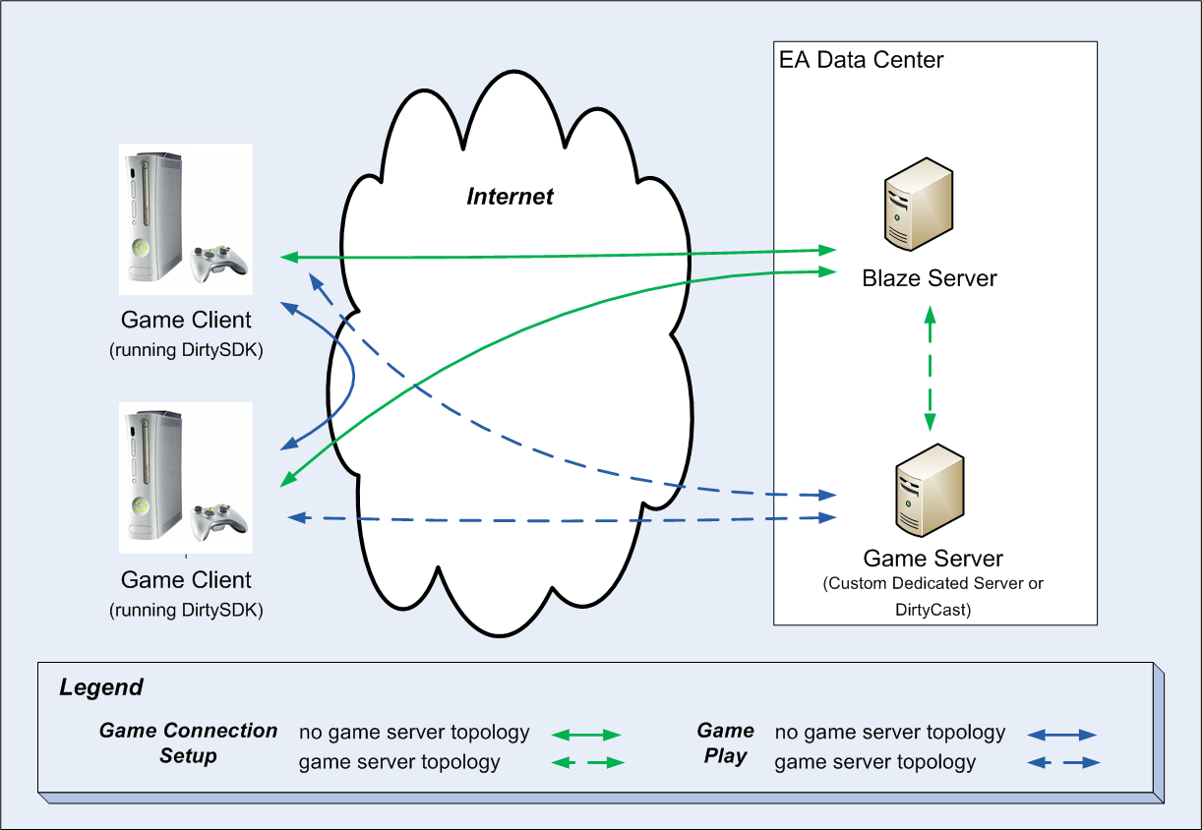
Blaze/DirtySDK integration (1/3)

Slide 31
Blaze/DirtySDK integration (2/3)
Supported network topologies
Without game server
Peer-to-peer (aka peer mesh topology)
Peer hosted (aka star topology)
With game server
Dirtycast-based
DirtyCast OTP (NetGameDistMulti)
DirtyCast failover (peer mesh via server)
Dedicated Server

Slide 32
Blaze/DirtySDK integration (3/3)
ConnApiAdapter
Blaze requires the game code to implement a “Network Adapter” abstracting the underlying network tech
We provide a network adapter abstracting ConnApi.

Slide 33
Memory footprint, CPU cost
Memory use, code size
DirtySDK doesn’t reference itself from a central location. Unused modules: no cost.
Memory is mostly statically allocated, per-module, at creation. One time cost, freed upon module destroy.
CPU
Per usage. Module idlers.
Generally: not significant.

Slide 34
Key Confluence Links
Global Online Organization:
http://online.ea.com/confluence/display/eao/Global+Online+Organization
DirtySock customer portal:
http://online.ea.com/confluence/display/dirtysock/DirtySock+Customer+Portal
Blaze customer portal:
http://online.ea.com/confluence/display/blaze/Blaze+Customer+Portal

Slide 35

Q & A
Thank you!
And think !
GOS Dirtysock support
GOSDirtysockSupport@ea.com

